Slide 1
Maverick: A Stand-alone CAD Flow for Partially Reconfigurable FPGA Modules
Dallon Glick, Jesse Grigg, Dr. Brent Nelson, Dr. Michael Wirthlin

Slide 2
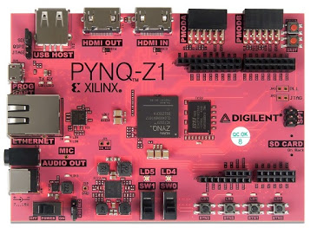
Research Goals
Create a non-vendor FPGA CAD flow
Run this flow on an embedded SoC
The PYNQ-Z1 Board
Maverick:
Stand-alone CAD flow for partially reconfigurable circuits
Synthesis, Packing, Placement, Routing, Bitgen
Operates on embedded platforms (Zynq)
Notes:
• At the beginning of this work, we had two research goals
◦ The first was to create a non-vendor FPGA CAD flow using third party CAD tools
◦ and the second, related goal, was to be able to run this CAD flow on embedded platforms such as the Zynq SoC on the PYNQ-Z1 board.
• With Maverick, we have met these goals.
• Maverick is a stand-alone CAD flow for partially reconfigurable circuits that performs all the steps of synthesis, packing placement, routing, and bitstream generation.
• Additionally, in addition to being able to run on regular desktop computers, Maverick is capable of running on embedded platforms such as the Zynq SoC.

Slide 3
Design Flow
Two Phases:
Static Design Phase (Vivado-dependent)
Create static design w/ Vivado’s partial reconfiguration (PR) flow
Generate associated metadata
Maverick Phase (Independent)
Compile reconfigurable modules (RMs)
Uses & extends Yosys, RapidSmith2, & Project X-Ray
Notes:
Our design flow is made up of two distinct phases:
The first phase is called the “Static Design” phase.
In this phase, we create a static design using Vivado’s partial reconfiguration flow as well as some related metadata.
We use this metadata in the next phase of our flow, which we call the Maverick phase.
- This phase can be used to compile reconfigurable modules and works through the use of third party CAD tools, including Yosys, RapidSmith2, and Project X-Ray.

Slide 4
Static Design Phase
Static Design
(Verilog)
Initial Bitstream
Vivado
Static Design Creation
Static Resources
RapidSmith2
Partial Device Generation
Partial Device
Project X-Ray
Database Generation
Bitstream Database
Notes:
The “Static Design Phase” can be further broken into three distinct steps.

Slide 5
Static Design Phase: Static Design Creation
Create Static Design w/ Vivado’s PR flow
Save initial partial bitstream
Static Region
FPGA
Static Circuitry
Export static resources
Reserved Wires & Site Route-throughs
Partition Pins, Partition Pin Routes
Static Circuitry
PR Region
Static Circuitry
Reserved Wires
Partition Pin
Notes:
After creating a static design with Vivado, we save an initial partial bitstream for later use.
• Importantly, we then export a list of static resources that cannot be used by reconfigurable modules.
When you create a static design in Vivado, it’s possible that it will use routing resources contained within the PR region for static logic.
These may either be wire segments or entire sites that Vivado routes through.
• We also have to save information about partition pins.
Partition pins are the points at which the static and reconfigurable logic interface.
Physically, they are wire segments located within the PR region.
• So, we use Vivado’s TCL interface to create and save a list of all of these partition pins and how they have been routed to by the static design.
In the first step, we use Vivado’s partial reconfiguration flow.
Vivado takes a slot-based approach to partial reconfiguration, where you define a static region containing unchanging circuitry and one or more PR regions, where you can swap reconfigurable modules in and out at run time.

Slide 6
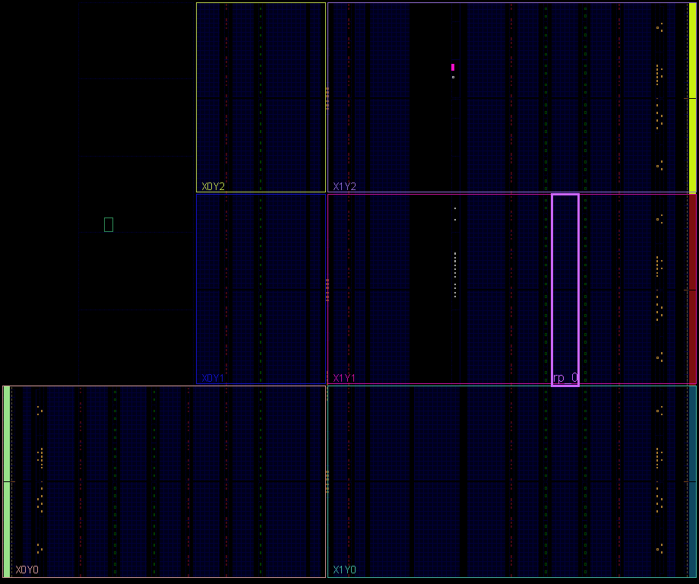
Static Design Phase: Partial Device Model
CLB
INT_L
INT_R
CLB
…
CLB
INT_L
INT_R
CLB
CLB
INT_L
INT_R
CLB
CLB
INT_L
INT_R
CLB
CLB
INT_L
INT_R
CLB
…
A Partial Device Model for a PR Region
Partial Device Generator: Represent only a PR region’s resources
Notes:
• In this step, we create a partial device model for use within RapidSmith2.
• RapidSmith2 normally uses device files that model full devices.
• But for this work, we created a partial device generator that generates a device file that represents only a PR region’s resources.
◦ This allows us to treat a PR region as its own mini-device within RapidSmith2.

Slide 7
Static Design Phase: Bitstream Database Generation
Project X-Ray¹:
Documents Xilinx 7-Series bitstream
Generates databases mapping device features to bits
Extended to support Zynq devices
Targeted PYNQ-Z1 board
The PYNQ-Z1 Board
[1] Project X-Ray. [Online]. Available: https://github.com/SymbiFlow/prjxray/
Notes:
• Project X-Ray is an open-source project that aims to document the Xilinx 7-Series bitstream format.
◦ It can be used to generate bitstream databases that map certain device features to bits in the bitstream.
• At the time of this work, Project X-Ray only targeted an Artix7 FPGA.
◦ For Maverick, we extended X-Ray to also work for Zynq FPGAs.
◦ We specifically targeted the ZYNQ on the PYNQ-Z1.

Slide 8
Static Design Phase
Static Design
(Verilog)
Initial Bitstream
Vivado
Static Design Creation
Static Resources
RapidSmith2
Partial Device Generation
Partial Device
Project X-Ray
Database Generation
Bitstream Database
Notes:
We have now produced the necessary data for the Maverick Flow Phase…

Slide 9
Maverick Flow Phase
RM Design
(Verilog)
Yosys:
Synthesis & Tech-Mapping
Partial Device
From Static Design
RapidSmith2:
Packing, Placement, Routing,
FASM Generation
Static Resources
Initial Bitstream
From Static Design
Project X-Ray
Bitstream Generation
Bitstream Database
.bit
[3] C. Wolf. Yosys Open SYnthesis Suite. [Online]. Available: http://clifford.at/yosys/
Notes:
• Once the static design phase has been completed, we have all the necessary information for the Maverick flow to generate new partial bitstreams for placed and routed designs within the PR region.
◦ This phase can either take place on a Workstation or an embedded platform.

Slide 10
Synthesis & Tech-Mapping (Yosys)
RM Design
(Verilog)
Yosys Open SYnthesis Suite²
Tech-Maps to Xilinx 7-Series
Produces EDIF netlists
Yosys:
Synthesis & Tech-Mapping
RapidSmith2: Packing
RapidSmith2: Placement
RapidSmith2: Routing
RapidSmith2:
FASM Generation
Project X-Ray: Bitgen
[2] C. Wolf. Yosys Open SYnthesis Suite. [Online]. Available: http://clifford.at/yosys/
.bit
Notes:
• Yosys, which has already been discussed today, is first used for Synthesis and tech-mapping.
• At the time of this work, Yosys did not support the full set of 7-Series device features.
◦ So, we currently only map to slice structures in the Maverick flow, though this can be changed in the future.

Slide 11
Packing & Placement
RM Design
(Verilog)
Packing (RSVPack³)
Group LUTs, FFs, etc. into site clusters
Performs intra-site routing
Yosys:
Synthesis & Tech-Mapping
RapidSmith2: Packing
RapidSmith2: Placement
RapidSmith2: Routing
RapidSmith2:
FASM Generation
[3] T. Haroldsen, B. Nelson and B. Hutchings, "Packing a Modern Xilinx FPGA Using RapidSmith,” in 2016 ReConFig, 2016, pp. 1-6.
Project X-Ray: Bitgen
.bit
Notes:
• Once Yosys generates the EDIF netlist, we move into the RapidSmith2-based steps of Maverick.
• Inside RapidSmith2, we first perform the packing step using the RSVPack algorithm.
◦ This packer groups related cells, such as LUTs and flip-flops, into site clusters and then performs the routing within those sites.

Slide 12
Packing & Placement
RM Design
(Verilog)
Packing (RSVPack³)
Group LUTs, FFs, etc. into site clusters
Performs intra-site routing
Placement (RSVPlace):
Places clusters onto actual sites
Modified to not use reserved sites
Yosys:
Synthesis & Tech-Mapping
RapidSmith2: Packing
RapidSmith2: Placement
RapidSmith2: Routing
RapidSmith2:
FASM Generation
[3] T. Haroldsen, B. Nelson and B. Hutchings, "Packing a Modern Xilinx FPGA Using RapidSmith,” in 2016 ReConFig, 2016, pp. 1-6.
Project X-Ray: Bitgen
.bit
Notes:
• Next, RSVPlace, a simulated annealing placer, is used.
◦ RSVPlace places the clusters onto specific sites of the PR region and was also modified to not use any sites reserved by the static design for routing.

Slide 13
Routing (RSVRoute)
RM Design
(Verilog)
RSVRoute: New RapidSmith2-based router
Primarily based on PathFinder
Inter-site router
Yosys:
Synthesis & Tech-Mapping
RapidSmith2: Packing
RapidSmith2: Placement
Partial Reconfiguration Support:
Routes to and from partition pins
Avoids wires reserved by static design
RapidSmith2: Routing
RapidSmith2:
FASM Generation
Project X-Ray: Bitgen
.bit
Notes:
• Next, a new RapidSmith2-based router, called RSVRoute, is used.
• RSVRoute is primarily based on the PathFinder Negotiated Congestion Routing algorithm and routes the nets between the sites of the PR region.
• Importantly, RSVRoute has two unique characteristics to support partial reconfiguration.
◦ First, in a reconfigurable module, nets connect not only to logic block pins but also to partition pins, which are wire segments within the PR region.
◦ RSVRoute is able to route to and from these partition pins, as well as logic block pins.
◦ Second, RSVRoute also takes special care to avoid using any wires that were reserved for use by the static design.

Slide 14
FASM Generation (RapidSmith2)
RM Design
(Verilog)
FPGA Assembly (FASM)
# LUT properties
CLBLL_L_X40Y13.SLICEL_X1.ALUT.INIT[01] 1
. . .
CLBLL_L_X40Y13.SLICEL_X1.ALUT.INIT[63] 1
# Net: Timer.tenthsCounter.count[1]
INT_R_X43Y29.NN2BEG1 LOGIC_OUTS1 . . .
Yosys:
Synthesis & Tech-Mapping
RapidSmith2: Packing
RapidSmith2: Placement
RapidSmith2: Routing
FASM File Sample
RapidSmith2:
FASM Generation
New RapidSmith2 FASM Generator
Project X-Ray: Bitgen
.bit
Notes:
• The last step of the Maverick flow that takes place within RapidSmith2 is the FASM generation step.
• FASM stands for FPGA Assembly and is a human-readable format introduced by Project-Xray.
◦ As the sample on the slide shows, a FASM file is essentially just a listing of configuration instructions for a design, such as configuring LUTs and turning on programmable connections to route a net.
• A RapidSmith2-based FASM generator parses all the data structures created through placement and routing to create a FASM that describes the physical implementation of the reconfigurable module design.

Slide 15
Bitstream Generation (Project X-Ray)
RM Design
(Verilog)
xc7PartialPatch
Patches initial partial bitstream w/ FASM
Uses Project X-Ray tools & bitstream database
Yosys:
Synthesis & Tech-Mapping
RapidSmith2: Packing
RapidSmith2: Placement
Produces a new partial bitstream!
RapidSmith2: Routing
RapidSmith2:
FASM Generation
Project X-Ray: Bitgen
.bit
Notes:
• Once the FASM file has been created, the bitstream generation step finally takes place.
• In this step, a program called xc7PartialPatch patches the initial partial bitstream saved earlier with the FASM file.
◦ This is done using the Project X-Ray tools and the bitstream database generated earlier.
• With this step, the Maverick Flow phase is complete and we have a new working partial bitstream.

Slide 16
Testing & Evaluation
Static Region
FPGA
Timer
Static Region:
Xilinx’s PS7 core
Clocking, I/O interfaces
PR Region:
8 columns x 50 rows of CLB & interconnect tiles
Processing System 7 (PS7) IP Block
Pattern
Watch
RS232
led
Reg. File
clk
segment
sw
LUT
FF
PR Region
anode
. . .
btn
dp
rxd
txd
LUT
FF
Static Design Used in PYNQ-Z1 Tests
Notes:
• To test and evaluate our work, we created a static design, following the steps of the static design phase I explained earlier.
with a single PR region and a set of small benchmarks to fit within a PR region that was made up 8 columns by 50 rows of CLB and interconnect tiles.

Slide 17
Testing & Evaluation
Tested on PYNQ-Z1 (XC7Z020)
650 MHz dual-core ARM Cortex-A9 CPU
512 MB RAM
The PYNQ-Z1 Board
Maverick Flow runs on ARM (PS)
Designs programmed to FPGA (PL)
ZYNQ PS
ZYNQ PL
Maverick Flow
Partial Bitstream
Notes:
• We then tested the Maverick Flow phase on the PYNQ-Z1 board, which has a ZYNQ SoC with an ARM processor and 512 MB of RAM.
• In our tests, we ran the Maverick flow on the Zynq’s ARM processor and programmed the resulting bitstreams directly to the Zynq’s FPGA.

Slide 18
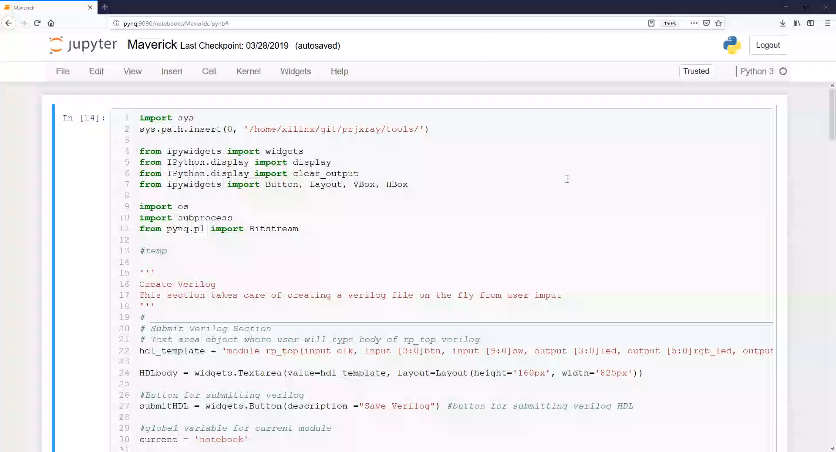
Maverick Jupyter Notebook
Notes:
• This video shows a Jupyter notebook we created being accessed through a web server running on the PYNQ-Z1’s ARM processor.
• This notebook lets us write Verilog for and then execute each step of the CAD flow within a web interface.
◦ In this instance, some Verilog for a stopwatch design is in the textbox.
◦ Once the Verilog is written, you can save it and then synthesize it.

Slide 19
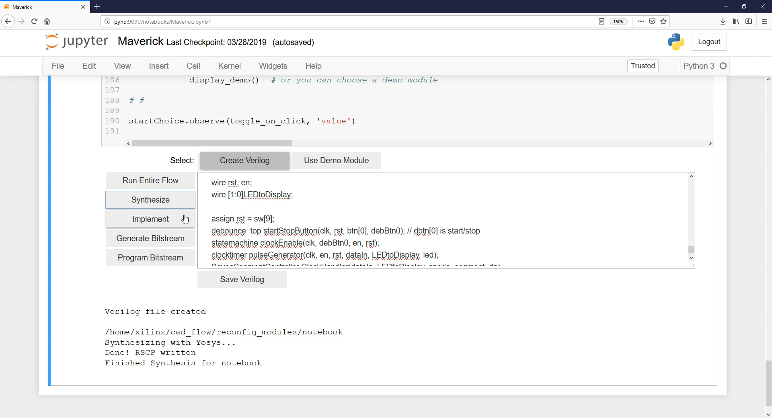
Maverick Jupyter Notebook
Notes:
• Once synthesis completes, you can click a button to perform the physical implementation steps of the CAD flow, including packing, placement, and routing.

Slide 20
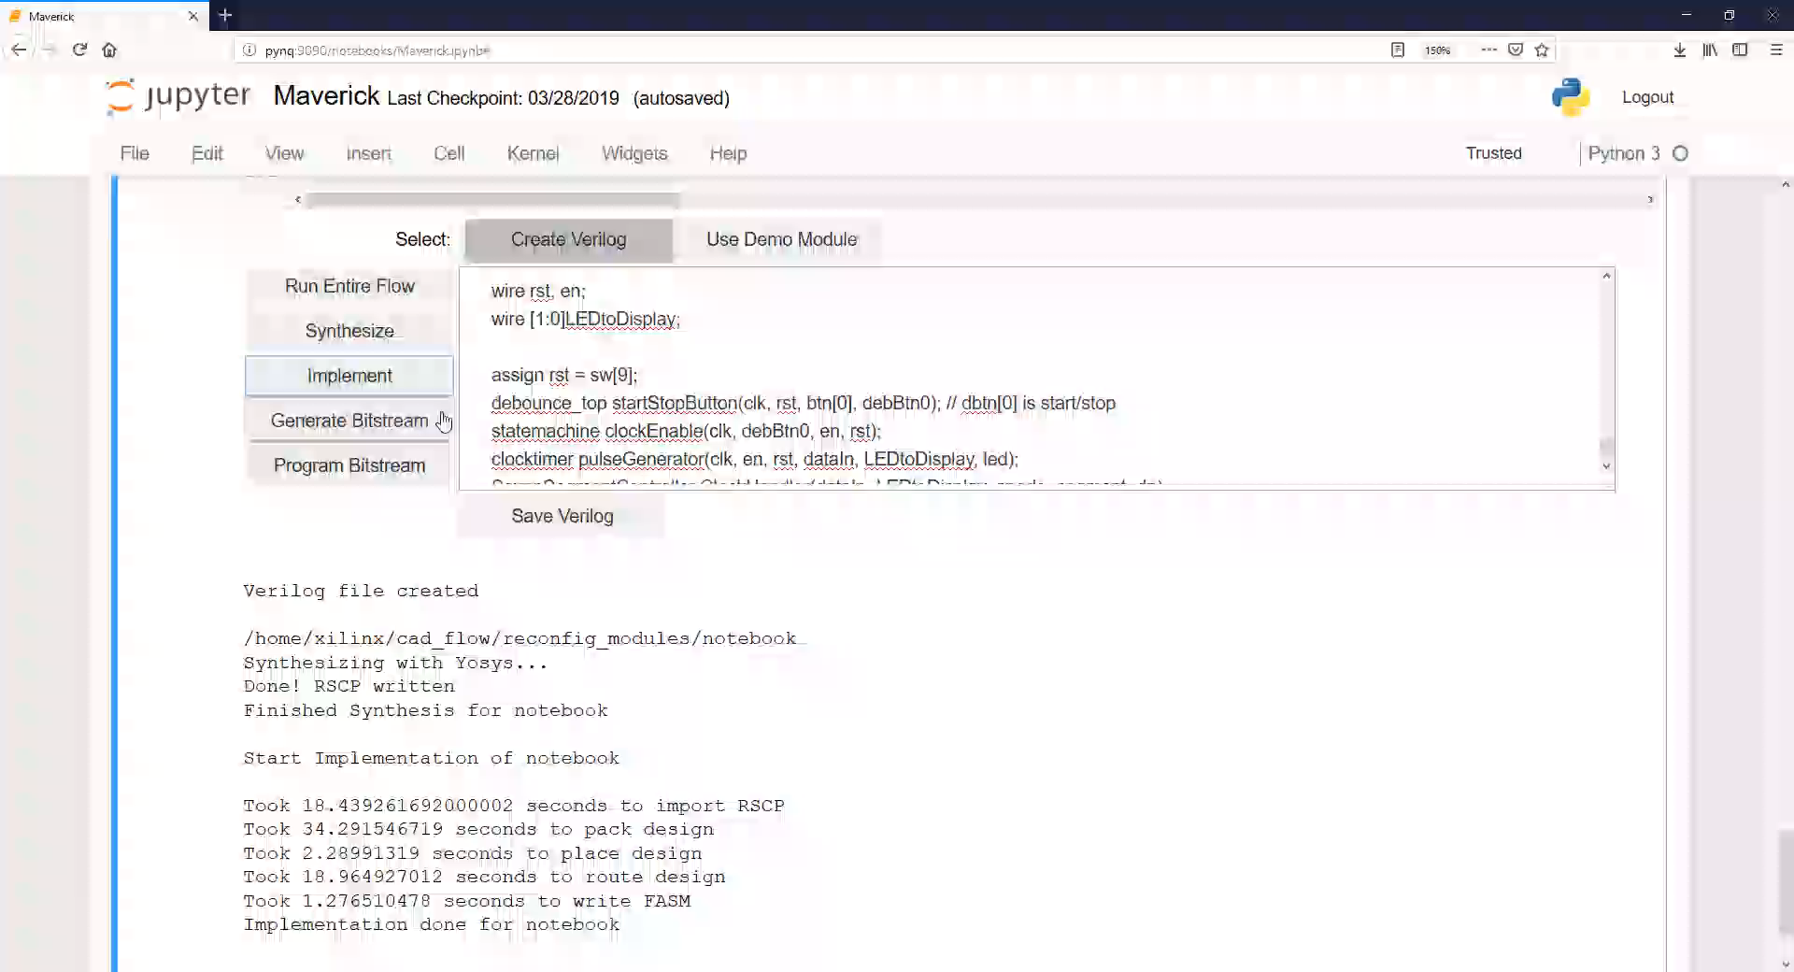
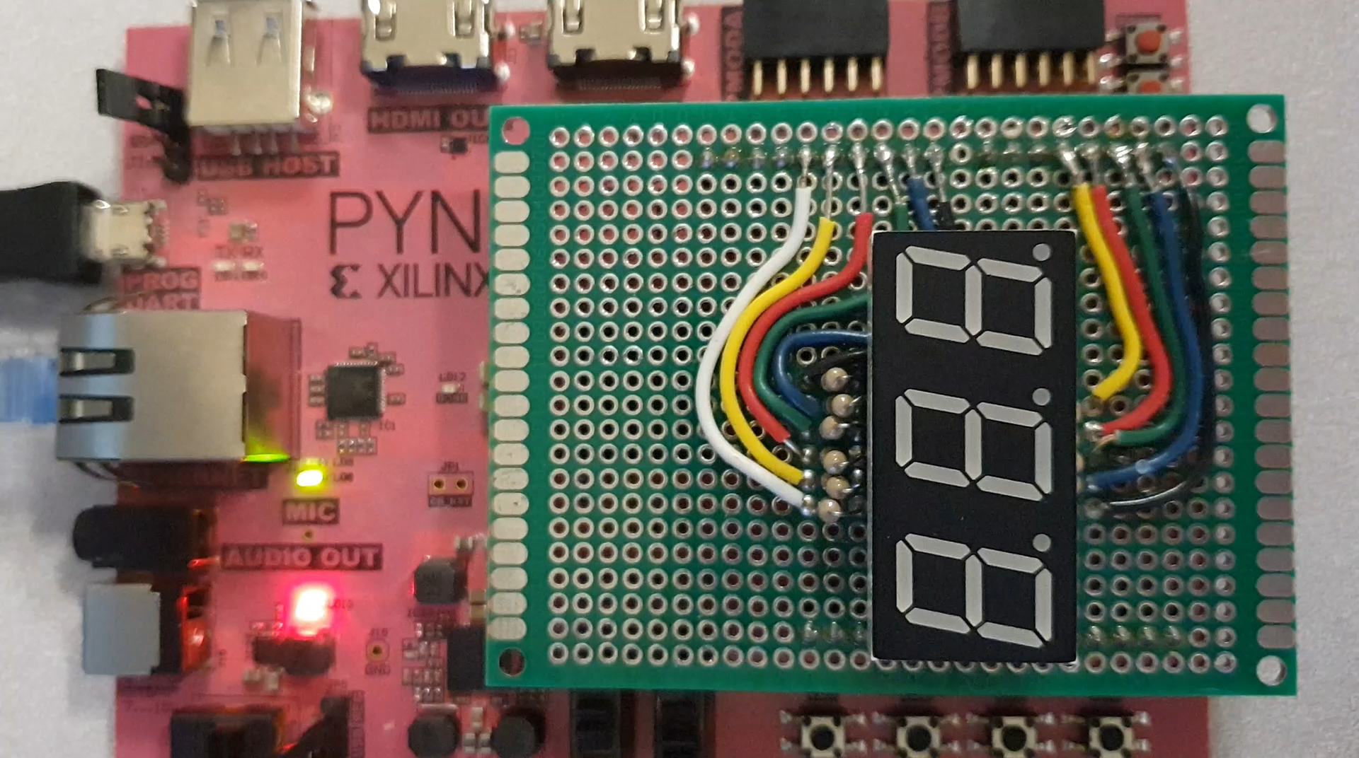
Maverick Jupyter Notebook
Notes:
• And once implementation completes, we can generate a partial bitstream and then program that bitstream directly to the FPGA.
• And as this video shows, it works! We are able to run this CAD flow on the PYNQ-Z1’s ARM processor and then program a working bitstream to the FPGA.
• I’ll now explain how this works in much more detail.

Slide 21
Benchmark Resource Utilization
 | Slices |  | LUTs |  | Flip-Flops
 | Maverick | Vivado | Maverick | Vivado | Maverick | Vivado
Register File | 28 | 21 | 47 | 26 | 9 | 9
RS232 Tx. | 53 | 42 | 174 | 114 | 55 | 48
Stopwatch | 57 | 46 | 232 | 136 | 67 | 65
Pattern Game | 79 | 58 | 319 | 187 | 117 | 109
Timer Game | 105 | 73 | 589 | 233 | 128 | 127
PR Region | 400 |  | 3200 |  | 3200
Zynq 7020 | 13300 |  | 106400 |  | 106400
FPGA Resource Utilization
Designs compiled with Maverick vs. Vivado-only
Notes:
• We tested the five designs shown on this table.
• This table shows the FPGA resource utilization for each design when compiled with Maverick and when compiled with Vivado only.
• All of these designs are small designs that a student might create as part of an introductory digital design course.
• As the table shows, Vivado was more efficient in terms of resource utilization for every design.
◦ However, the point of this work wasn’t to compete with Vivado so we find these results to be acceptable for goals.

Slide 22
Benchmark Run Time Results
Maverick Run Times on PYNQ-Z1
Notes:
• We also measured the runtime for the Maverick flow for each design, as shown by the plot on this slide.
• The largest design, the timer game, took slightly over 2 minutes to compile on the ARM.
• As the design sizes grew, the runtime naturally increased as well, with the RapidSmith2-based steps growing more quickly than the synthesis and bitstream generation steps.
◦ As the plot shows, the packing and routing steps took the most time for each design, while the placer completed very quickly in comparison.
◦ However, compiling these designs was 6-11x faster on a computer with an i7 processor.

Slide 23
Benchmark Peak Memory Usage
Peak Memory Usage on PYNQ-Z1
Notes:
• We also measured the peak memory usage for the different steps of the Maverick flow.
• Naturally, the memory required also grew as the designs grew.
◦ Yosys and Project X-Ray consistently used a similar amount of memory, while RapidSmith2 required a more noticeable increase in memory for each design.
◦ The largest design peaked at 230 MB for memory usage, with there being 512 MB of RAM available on the PYNQ-Z1 board.
• RapidSmith2 likely requires the most memory for a number of reasons.
◦ This includes the memory needed to represent the PR region within RapidSmith2, as well as the memory needed for the data structures, such as routing graphs, created by the implementation algorithms.
(Specifically, Yosys required 24 MB, the RapidSmith2-based programs 230 MB, and the
Project X-Ray tools 14 MB of RAM.)

Slide 24
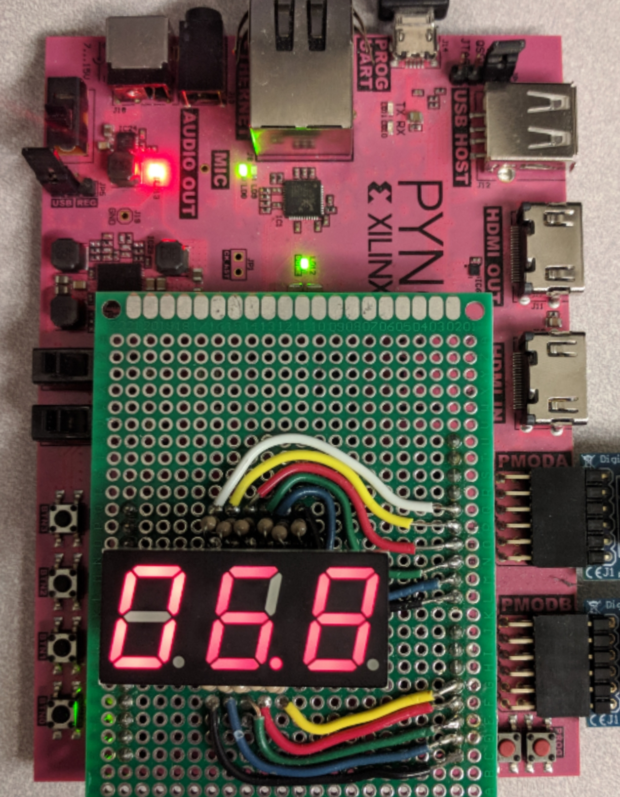
Conclusion
Summary
Non-vendor CAD flow for RMs
Runs on embedded platforms & SoCs
Future Work
Open sourcing remaining portions
Support additional device features
Stand-alone educational system
Self-adaptive systems
Stopwatch Compiled with Maverick
Questions?
https://github.com/byuccl/
Notes:
• To summarize, with Maverick we have created a non-vendor CAD flow for reconfigurable modules.
• We have successfully tested and generated working partial bitstreams for several designs, such as the stopwatch design shown on the right.
• In addition to simply improving the performance and utilization results of our tools, we have several other ideas for future work.
◦ First, many of the tools Maverick relies on are already open sourced and available for download.
However, there are a few portions remaining, such as the router, that we hope to open source in the near future. These tools will be available on the BYU configurable Computing Lab github page, which I have a link for on this slide.
◦ Additionally, future work could involve adding support for a larger subset of the Xilinx 7-Series family of devices.
◦ Finally, we plan on investigating integrating Maverick more with PYNQ and the Jupyter Notebook to create a stand-alone educational system.
Thank you. Are there any questions?
Should I put github links somewhere?

Slide 25






3rd Party CAD and Related Work
Cooperative Frameworks
Interface w/ vendor tools
Rely on vendor tools for portions of CAD flow
Stand-alone tools
Do not interface w/ vendor tools
“Replace” vendor tools
Maverick:
Uses & extends Yosys, RapidSmith2, & Project X-Ray
Notes:
• To do this, Maverick uses and extends some 3rd Party CAD tools.
• There are now several 3rd Party CAD tools available.
• Some of these tools are cooperative frameworks that can interface with the vendor tools.
• These cooperative tools are usually used to make some adjustments to a design implementation and the vendor tools are used for the rest of the CAD flow.
• There are also tools that are more stand-alone in nature.
◦ These tools typically do not or cannot interface with the vendor tools and are used to replace a portion of the CAD flow or the entire CAD flow provided by the Vendors.
• Maverick uses and extends a combination of these tools. Specifically, it uses Yosys for synthesis, RapidSmith2 for the physical implementation steps, and Project X-Ray for the bitstream generation step of the CAD flow.

Slide 26
Partial Reconfiguration (PR)
Vivado’s PR Flow:
Slot-based approach: Swap reconfigurable modules (RMs) in and out
Implement RMs w/in context of a locked static design
FPGA
Static Region
RM A3
RM A2
PR Region A
RM A1
Maverick:
Separate initial static design creation from later RM creation
Compile RMs independently of Vivado
Basic Premise of Partial Reconfiguration
Notes:
• First off, we use partial reconfiguration in this flow.
• The bitstream we generated and programmed in the video I just showed you was a partial bitstream.
• Vivado takes a slot-based approach to partial reconfiguration.
• In this approach, you define a static region which typically contains unchanging circuitry such as external I/O interfaces and you also define one or more PR regions.
• You can swap reconfigurable modules in and out of these PR regions at runtime.
• In Vivado you lock down this static design and implement all of your reconfigurable modules within that context.
• In Maverick, we separate the initial static design creation from later reconfigurable module creation.
• We still create the initial static design within Vivado, but once this is done, we can compile later reconfigurable modules independently of Vivado.

